Slide 1
CS574 Object-Oriented Analysis & Design
Gui Prototype of AbeBooks Log In Use Case
As it turns out, the log in use case’s name in AbeBooks.com is Sign On. It starts on the next slide.

Slide 2
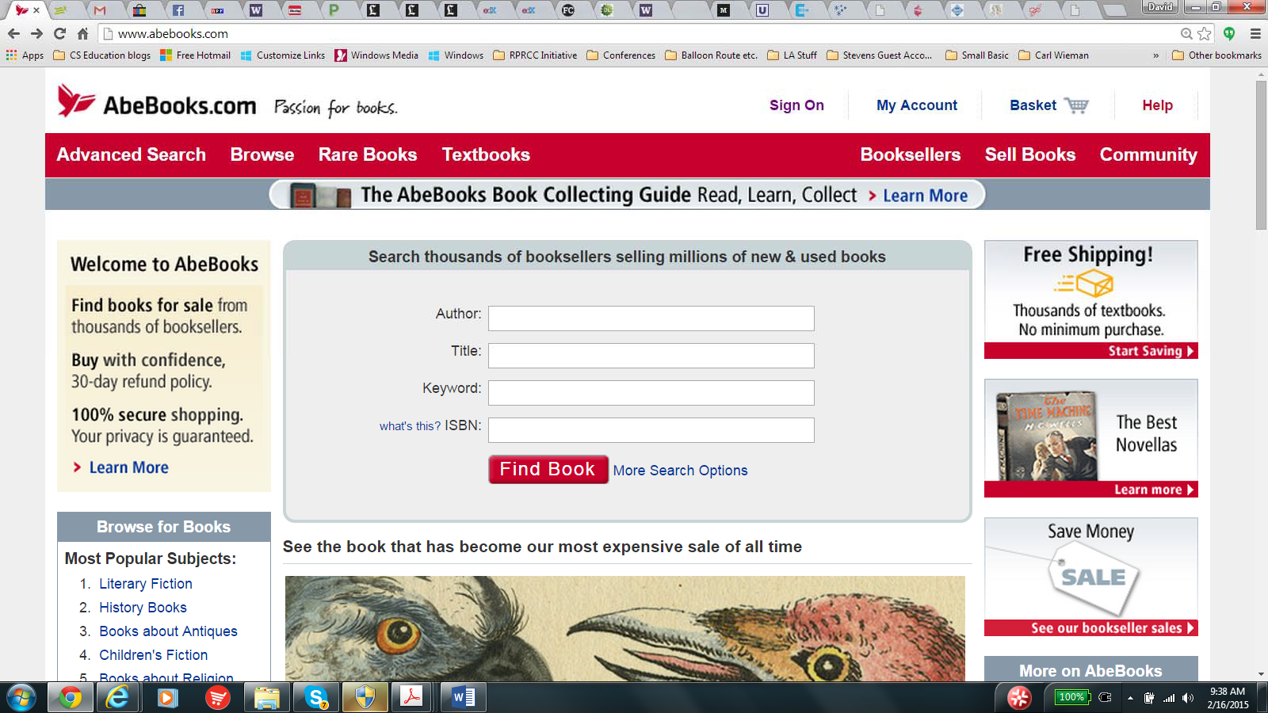
CS574 Object-Oriented Analysis & Design
Sign On Use Case
Basic Course The user clicks on Sign On the home page

Slide 3
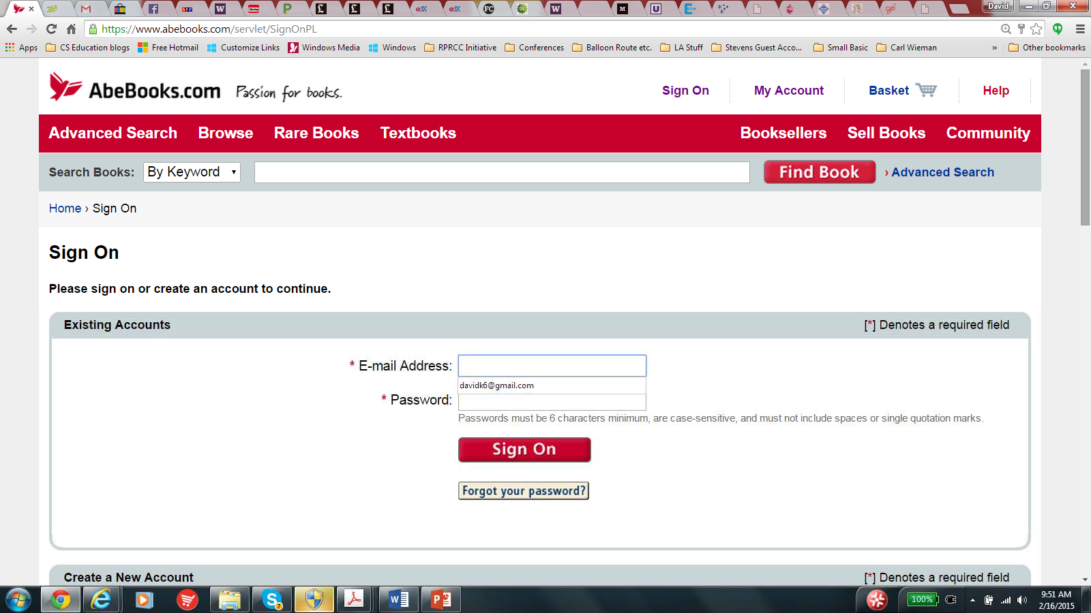
The system brings the user to the Sign On page
CS574 Object-Oriented Analysis & Design

Slide 4
CS574 Object-Oriented Analysis & Design
The user enters an email address and a password and clicks on Sign On. The system validates the email address and password and that they belong to an existing AbeBooks.com account.
Note that the arrow is needed here because there are two locations on this page named “Sign On”

Slide 5

The system brings the user to the home page.
CS574 Object-Oriented Analysis & Design

Slide 6
CS574 Object-Oriented Analysis & Design
Sign On Use Case
Alternate Course
If the user:
leaves either the email address or the password empty before clicking on Sign On,
or enters an invalid email address and/or an invalid password before clicking on Sign On,
or enters a valid email address and a valid password before clicking on Sign On, but the (email address, password) pair do not correspond to an AbeBooks.com account,
the system returns an error message that enables the user to try again.
If the user clicks on “Forgot your password?,” the system sends the user an email that enables her/him to create a new password.

Slide 7
CS574 Object-Oriented Analysis & Design
In order to get additional practice with composing use case text we will look at a number of additional reverse engineered use cases of abebooks.com

Slide 8
CS574 Object-Oriented Analysis & Design
We’ve already found that the AbeBooks.com use case that corresponds to the Internet Bookstore’s Open Account is Create a New Account, and we have constructed low‐level use case text for it.
In fact, we have constructed a GUI prototype for it, that is, GUI shots together with the relevant use case text. In general we’ll be interested in complete GUI prototypes, not just use case text.
We’ve also found the AbeBooks.com use case that corresponds to the Internet Bookstore’s Log In – named Sign On – and have constructed a GUI prototype for it.
But what about Internet Bookstore’s Search by Author and Browse List of Books use cases? Does AbeBooks.com have similar use cases?
There is no Search by Author use case in AbeBooks.com, but, rather, there is are two use cases that extend Search by Author; we’ll call them Simple Search and Advanced Search. For reasons that will become clear later, we’ll start with Advanced Search.

Slide 9
CS574 Object-Oriented Analysis & Design
Advanced Search Use Case
Basic Course
The user clicks on Advanced Search on AbeBooks.com’s home page

Slide 10
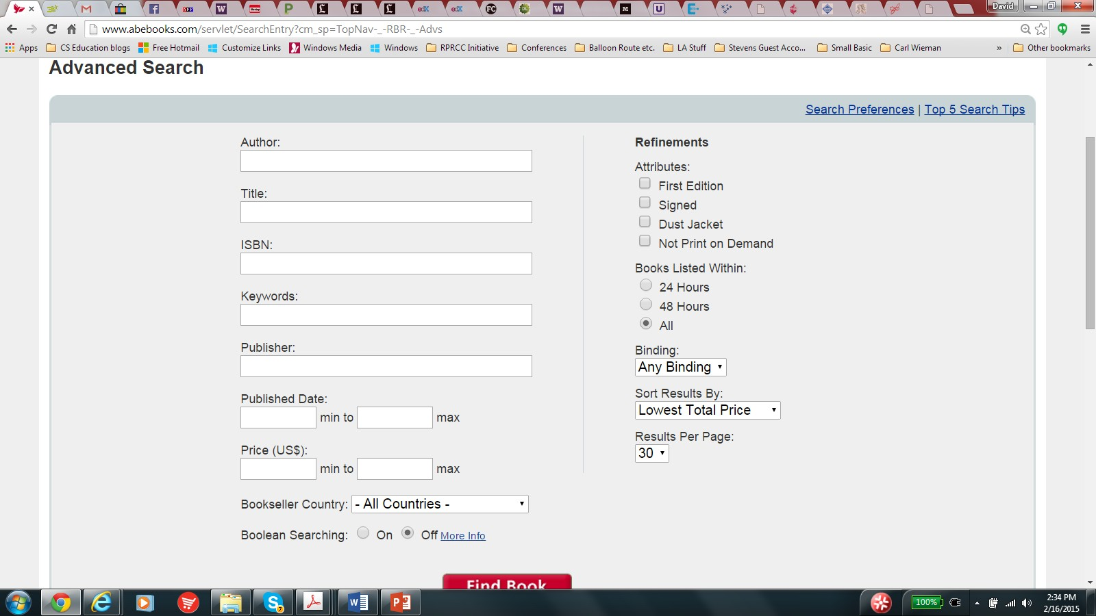
CS574 Object-Oriented Analysis & Design
The system brings the user to the Advanced Search page

Slide 11
CS574 Object-Oriented Analysis & Design
Before we continue with the GUI prototype for Advanced Search, we note that every book in AbeBook.com’s catalog must contain:
The name(s) of the author(s) of the book
The title of the book
The book’s ISBN (International Standard Book Number)
The name of the book’s publisher
The book’s year of publication
The book’s price
The bookseller’s country
Continued on next slide

Slide 12
CS574 Object-Oriented Analysis & Design
An indication that the book is a first edition if it is a first
edition
An indication that the book is signed – by the author or by someone else – if it is, in fact, signed
An indication that the book has a dust jacket, if, in fact, it has one
An indication that the book is Print on Demand if, in fact, it is
The date and time that the book was added to the AbeBooks.com’s catalog
Whether the book is hard cover or soft cover

Slide 13
CS574 Object-Oriented Analysis & Design
A textual description of the book. (Note that a keyword is any word in any in any of the fields listed on the last two slides or in the book’s textual description, so searching on a specific keyword will result in the system’s retrieving the catalog entry for all books that have that specific keyword in any one or more of these fields.)

Slide 14
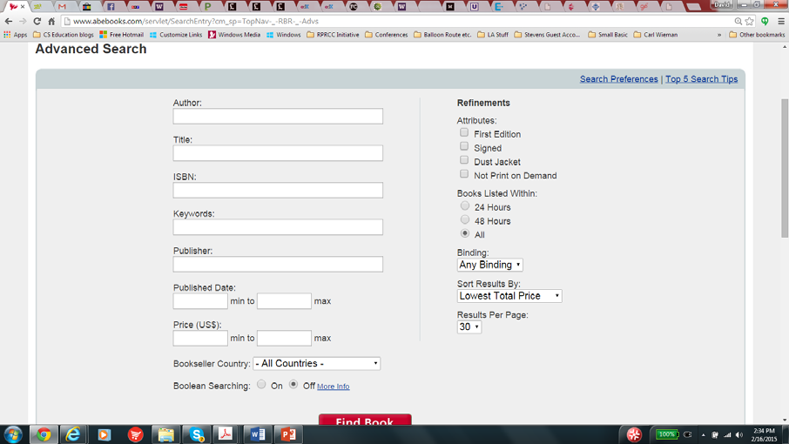
CS574 Object-Oriented Analysis & Design
Advanced Search Use Case
Basic Course (continued) The user does one or more of the following:
Enters a character string into the Author box
•
•
Enters a character string into the Title box
Enters a number into the ISBN box
Continued on next slide

Slide 15
CS574 Object-Oriented Analysis & Design
Advanced Search Use Case
Basic Course (continued)
Enters a character string into the Keywords box
Enters a character string into the Publisher box
Continued on next slide

Slide 16
Then the user does zero or more of the following:
CS574 Object-Oriented Analysis & Design
Enters a year (four digit integer) into the left box of Published Date
Enters a year (four digit integer) into the right box of Published Date
Continued on next slide

Slide 17
Then the user does zero or more of the following:
CS574 Object-Oriented Analysis & Design
Enters a price into the left box of Price
Enters a year (four digit integer) into the right box of Price
Continued on next slide

Slide 18
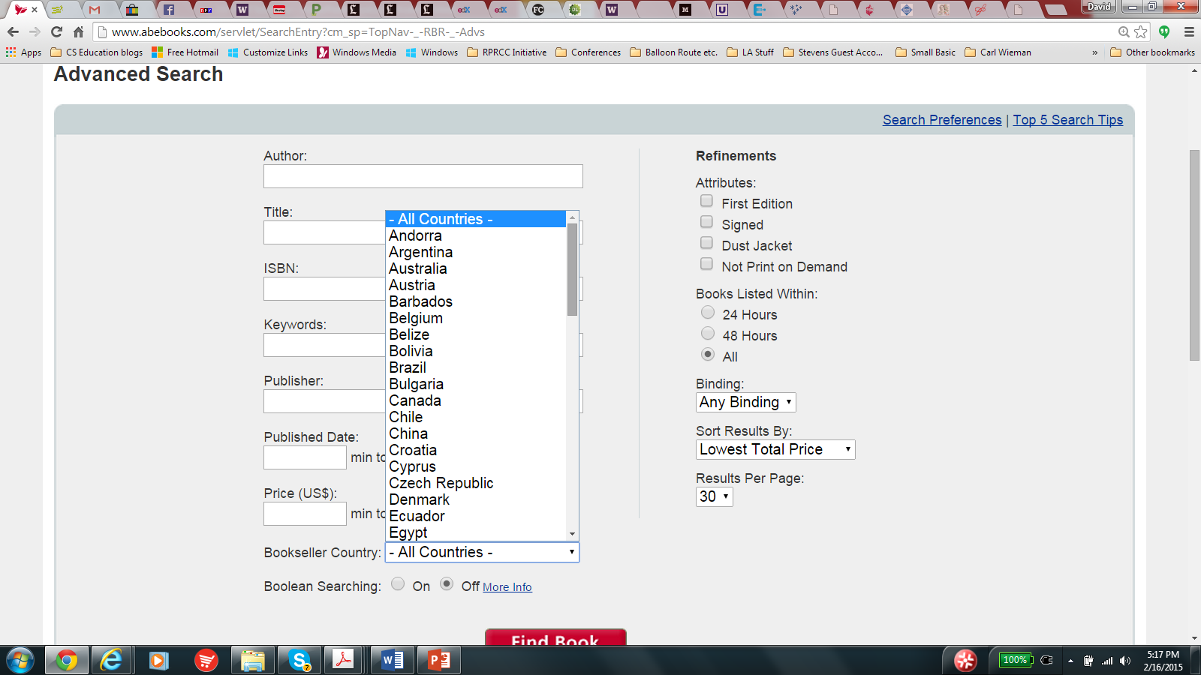
CS574 Object-Oriented Analysis & Design
Clicks on the Bookseller Country pull down list and selects one of the listed countries

